Slide 1
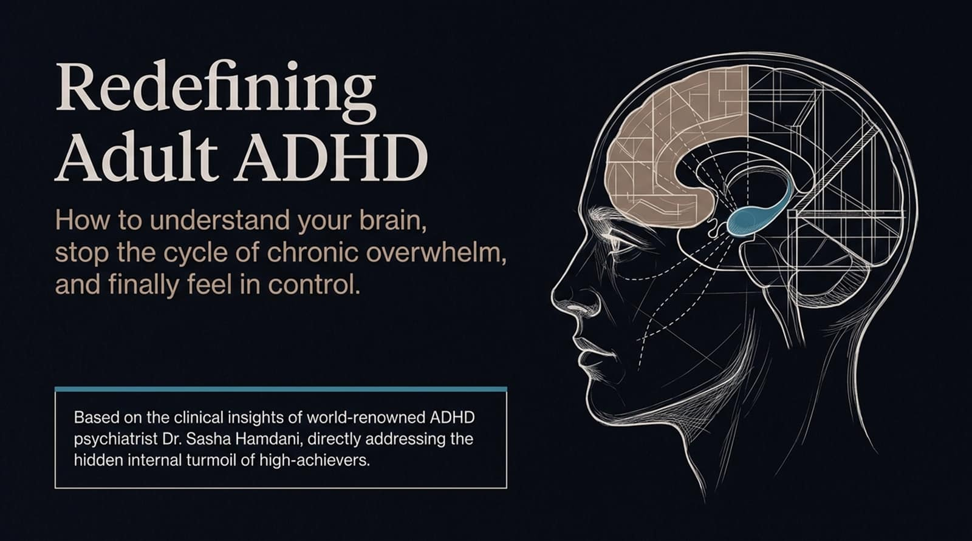
Notes:
Welcome everyone. Today we are stepping past the common cultural tropes and eye-rolls surrounding ADHD.
Most people think ADHD is just about a hyperactive child bouncing around a classroom or someone who easily gets distracted by shiny objects. But as world-renowned psychiatrist Dr. Sasha Hamdani emphasizes, ADHD at its core is a regulation disorder.
If you are a high-achiever who has spent years silently battling chronic overwhelm, internal anxiety, and self-criticism, this session is designed to give you clarity.
We are here to dismantle the shame: Your brain isn't broken—it’s just wired differently.
elivery Tip: Warm, empathetic tone. Pause after saying "your brain isn't broken" to let the core message land.
https://www.youtube.com/watch?v=nUPQImuDUng

Slide 2
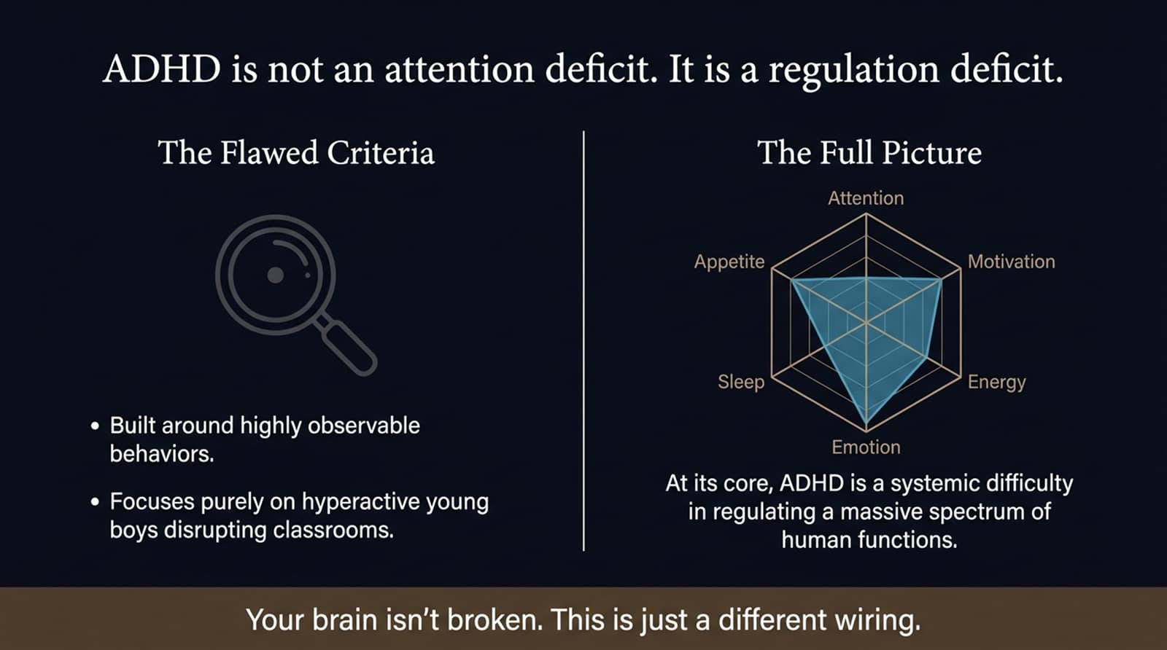
Notes:
Look at the hexagon chart on the right side of the slide. Traditional DSM diagnostic criteria were built decades ago, largely observing hyperactive young boys who disrupted classrooms.
Because it focused on observable external behavior, the diagnostic system overlooked how ADHD dysregulates an entire systemic network: Attention, Motivation, Energy, Emotion, Sleep, and Appetite.
Emotion: Experiencing wild swings in mood or sudden emotional floods.
Sleep & Energy: Difficulty falling asleep, fragmented sleep, or dramatic crashes in physical/mental stamina.
Appetite & Motivation: Forgetting to eat for hours when hyperfocused, or reaching for quick dopamine fixes.
Delivery Tip: Use the visual radar chart to walk the audience around each axis.

Slide 3
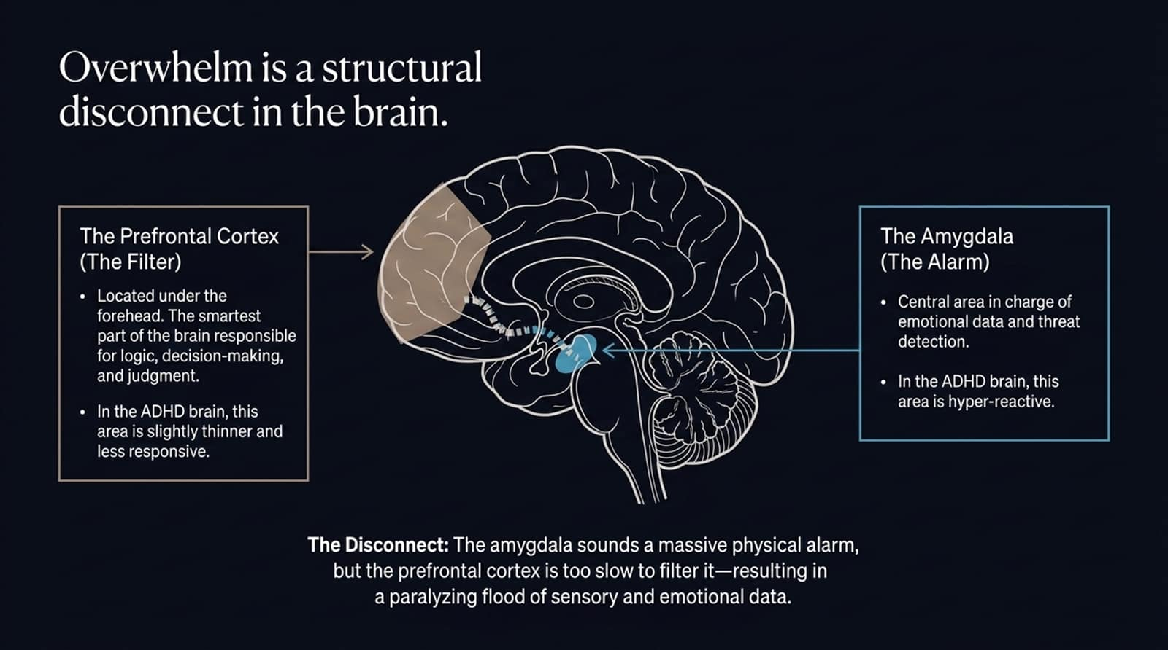
Notes:
Let's take a look under the hood to see why emotional overwhelm happens at a structural level.
Directly behind your forehead sits the Prefrontal Cortex—the executive filter responsible for logic, decision-making, and emotional modulation. In the ADHD brain, this cortex is slightly thinner and less responsive.
Deep in the brain lies the Amygdala, our threat-detection alarm system. In ADHD individuals, the amygdala is hyper-reactive.
When a stressor occurs, the amygdala sounds a massive alarm chemical flood. Because the connection between the two areas is weaker, the prefrontal cortex cannot step in fast enough to filter the input. This results in sensory and emotional overload.
Delivery Tip: Point to the prefrontal cortex and amygdala on the slide diagram.

Slide 4
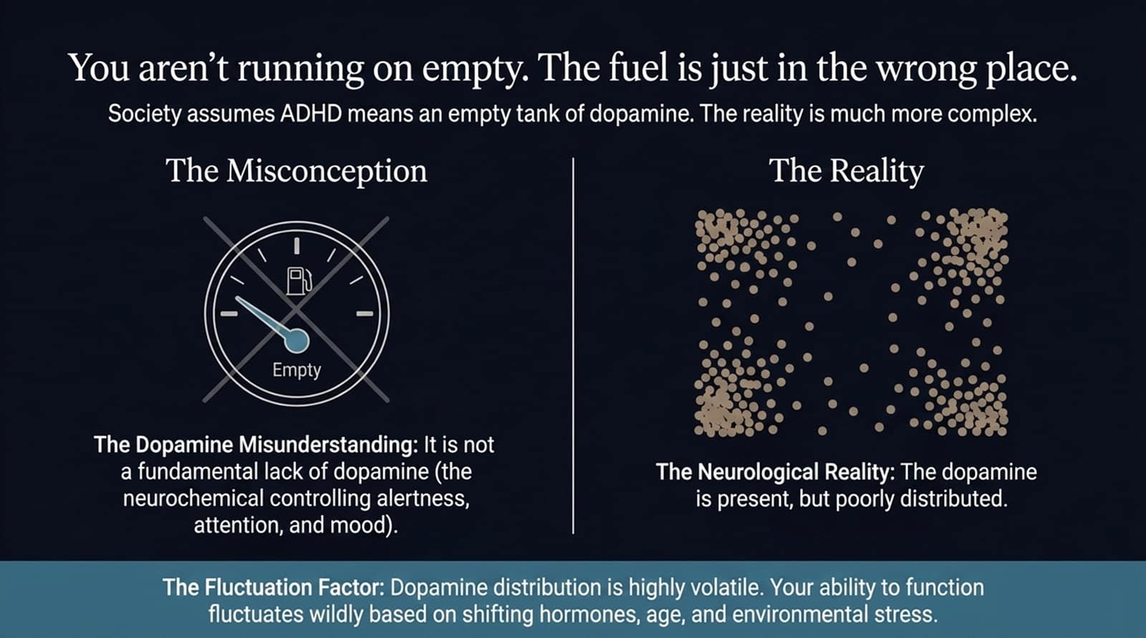
Notes:
Popular culture often claims that ADHD simply means having an "empty tank" of dopamine. That is a complete misconception.
Dopamine—the neurotransmitter responsible for alertness, motivation, and mood—is actually present in the ADHD brain, but it is inefficiently distributed.
Because dopamine delivery is unstable, your executive functioning fluctuates wildly depending on stress, environment, and hormonal changes.
This explains why you can hyperfocus on a passionate project for 8 hours without eating, but feel utterly paralyzed when trying to initiate a simple administrative task.
Delivery Tip: Contrast the "Empty Gas Tank" icon with the scattered dopamine dots.

Slide 5
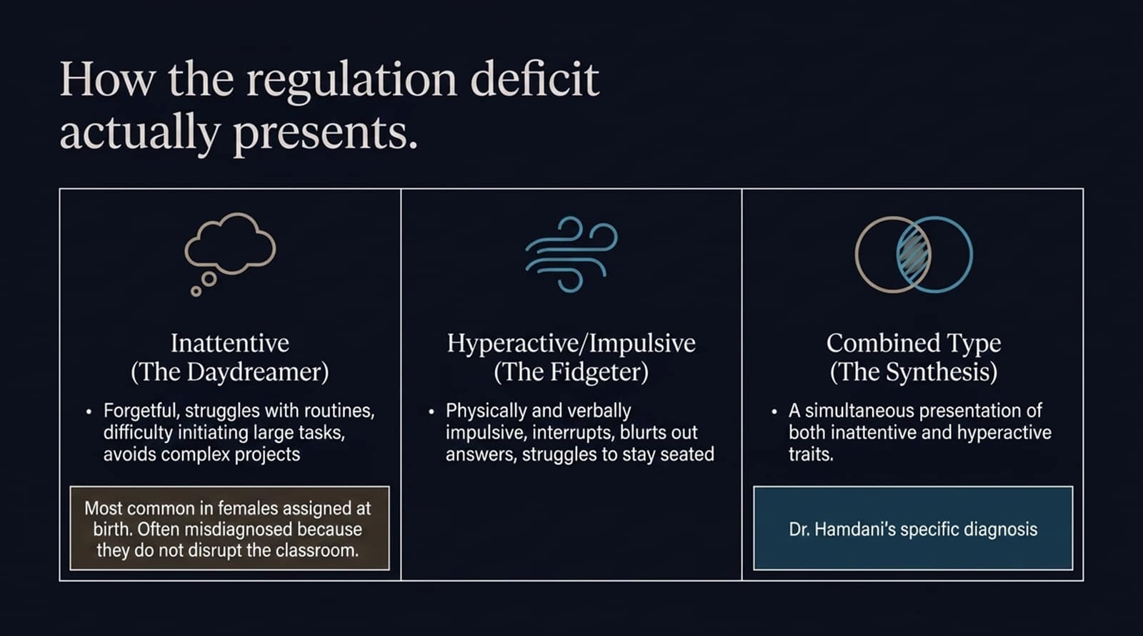
Notes:
The medical field categorizes ADHD into three main presentations:
Inattentive Type (The Daydreamer): Characterized by forgetfulness, difficulty initiating or finishing tasks, and avoidance of complex projects. Most common in females, often flies under the radar because it doesn't cause classroom disruption.
Hyperactive/Impulsive Type (The Fidgeter): Characterized by physical restlessness, interrupting others, and verbal impulsivity.
Combined Type (The Synthesis): A simultaneous presentation of both inattentive and hyperactive traits. (This is Dr. Sasha Hamdani’s personal diagnosis).
Delivery Tip: Emphasize that identifying your subtype is crucial for targeted coping strategies.

Slide 6
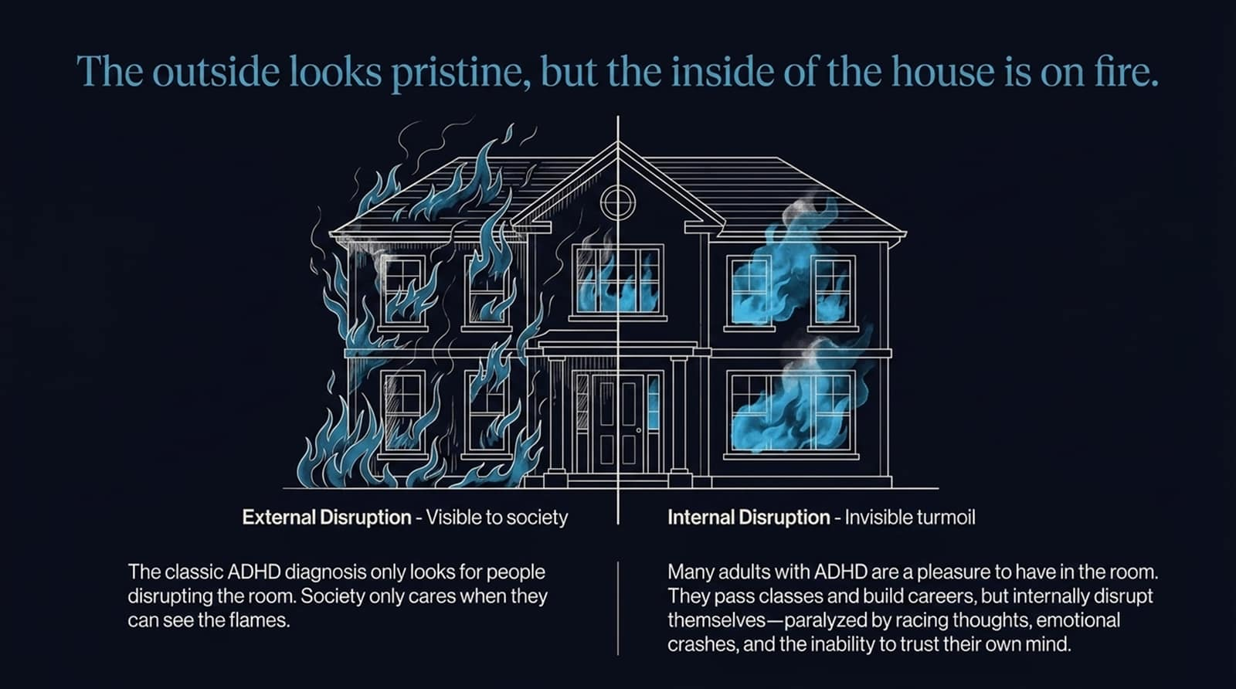
Notes:
This slide captures the essence of adult ADHD in high-achievers.
External Disruption: Society only reacts when it sees visible flames—trouble in school, acting out, or open disorganization.
Internal Disruption: High-functioning adults maintain a pristine exterior—holding successful careers and managing households. But internally, the house is on fire.
You spend immense energy managing racing thoughts, sudden emotional crashes, and a chronic inability to trust your own follow-through.
Delivery Tip: Reference the dual illustration of the burning house to highlight the contrast between public presentation and private struggle.

Slide 7

Notes:
To survive in a neurotypical world, many individuals—especially women—develop Masking.
Masking includes staying late to over-prepare, relentless perfectionism, avoiding conflict at all costs, and internalizing blame.
While this keeps the outer mask intact, the psychological toll is devastating: chronic anxiety, emotional exhaustion, and inevitable burnout.
Eventually, the mask becomes too heavy to hold.
Delivery Tip: Speak directly to the high-achievers in the audience who rely on perfectionism as a coping mechanism.

Slide 8
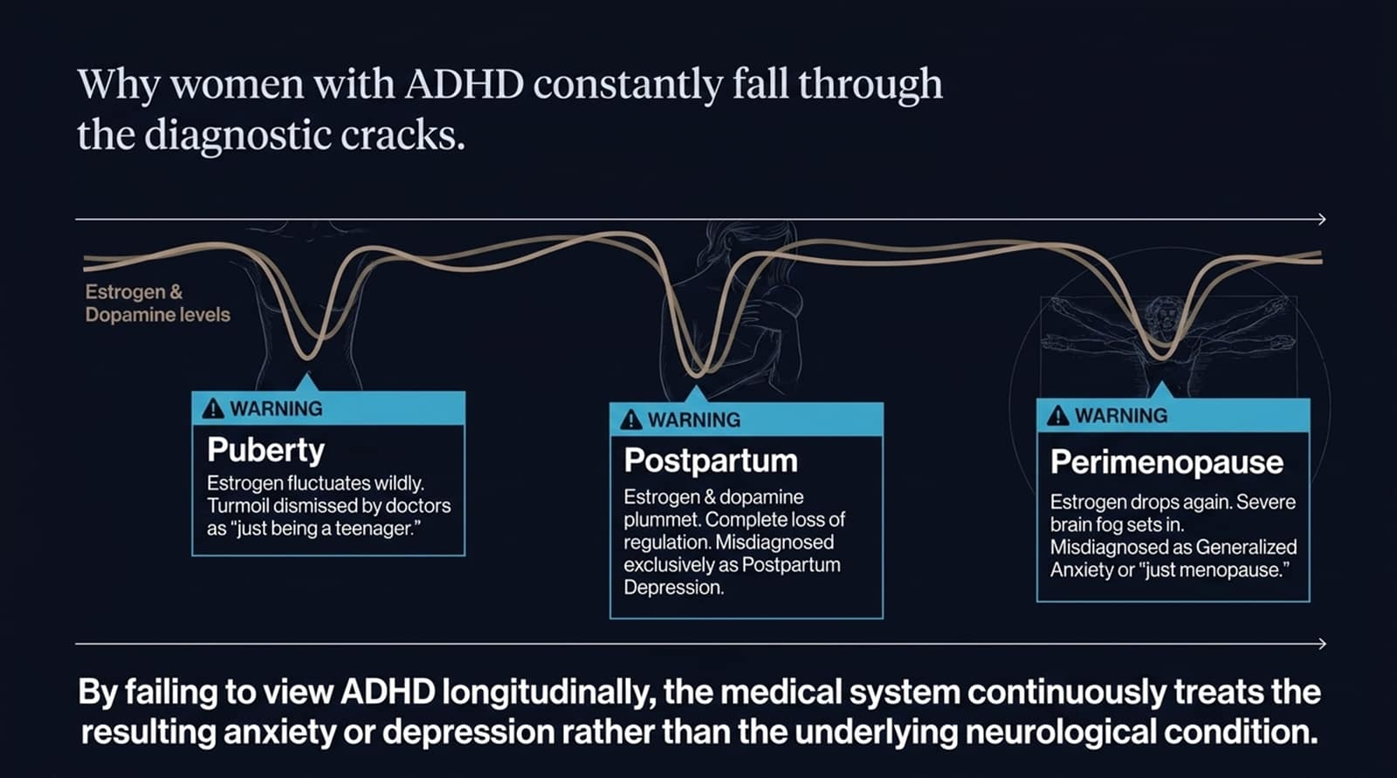
Notes:
Estrogen plays a critical role in modulating dopamine production. When estrogen drops, dopamine drops, worsening ADHD dysregulation.
Puberty: Fluctuating hormones impair focus and mood, often dismissed as "teen angst".
Postpartum: A drastic plummet in estrogen leads to severe executive dysfunction, frequently misdiagnosed solely as Postpartum Depression.
Perimenopause: Dropping estrogen causes severe brain fog and executive paralysis, often misdiagnosed as Generalized Anxiety or standard menopausal changes.
Because medicine rarely evaluates ADHD longitudinally across a woman's life, millions are treated for secondary symptoms while the root cause goes unaddressed.
Delivery Tip: Walk step-by-step through the timeline (Puberty $→$Postpartum $→$Perimenopause).

Slide 9
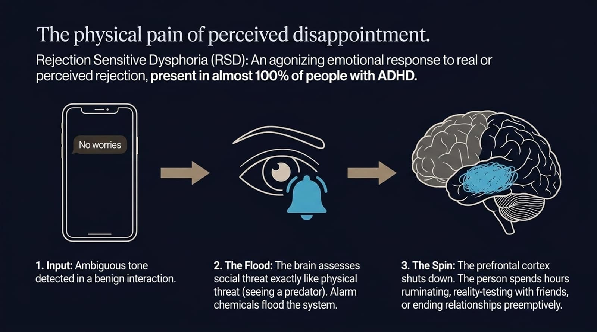
Notes:
Almost 100% of individuals with ADHD experience Rejection Sensitive Dysphoria (RSD).
1. Input: You receive a brief, ambiguous message like "No worries" or sense a minor shift in someone's tone.
2. The Flood: Your hyper-reactive amygdala perceives social danger as a physical threat, flooding your body with panic neurochemicals.
3. The Spin: Your prefrontal cortex goes offline. You spend hours ruminating, double-checking with friends, over-apologizing, or cutting off relationships preemptively to avoid rejection.
Delivery Tip: Use the text message visual ("No worries") to illustrate how a minor event can trigger a major internal spiral.

Slide 10
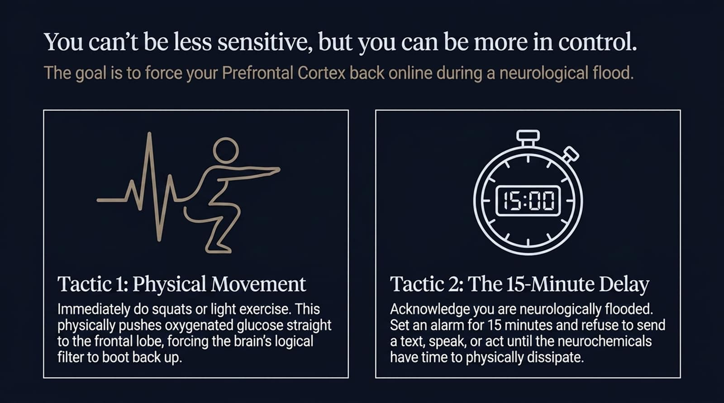
Notes:
The goal isn't to erase your sensitivity; it's to stay in control during a neurological flood. Dr. Hamdani recommends two actionable tactics:
Tactic 1: Physical Movement (e.g., Squats): Performing short bursts of physical exercise forces oxygenated glucose directly to the frontal lobe, helping the brain's logical filter reboot.
Tactic 2: The 15-Minute Delay: Recognize that you are neurologically flooded. Set a timer for 15 minutes and commit not to text, speak, or make decisions until the chemical surge dissipates.
Delivery Tip: Keep delivery energetic and practical.

Slide 11
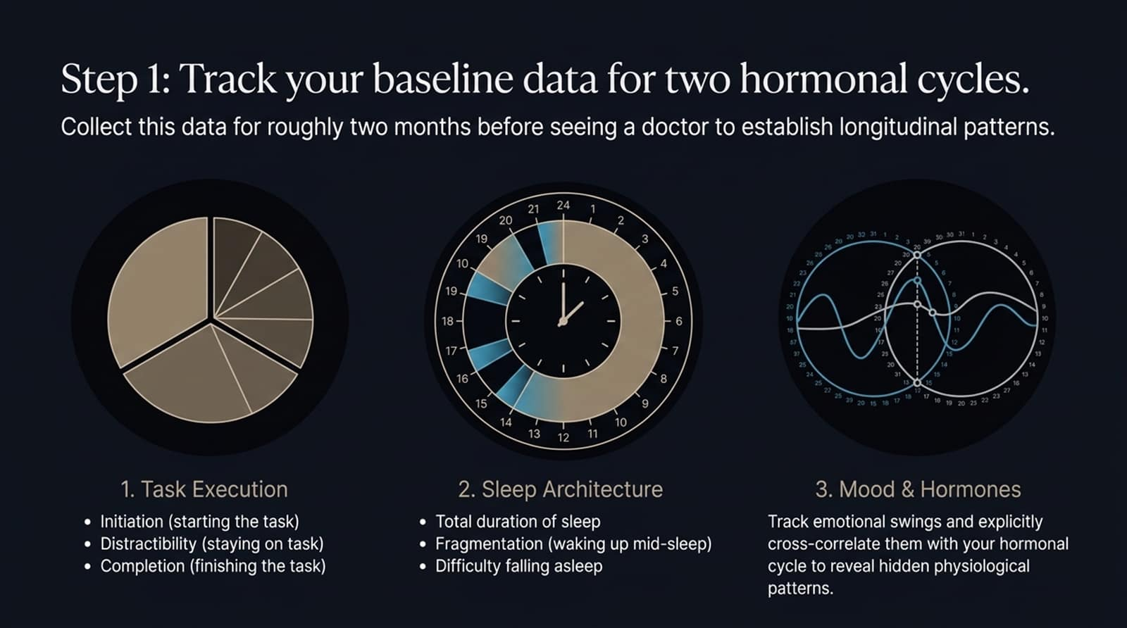
Notes:
When seeking an evaluation, come equipped with objective data. Log the following areas over 60 days:
Task Execution: Measure Initiation (starting), Distractibility (staying focused), and Completion.
Sleep Architecture: Log duration, night awakenings, and difficulty falling asleep.
Mood & Hormones: Track emotional swings alongside your monthly hormonal cycle to spot physiological patterns.
Delivery Tip: Highlight that simple phone notes are enough to gather meaningful baseline data.

Slide 12
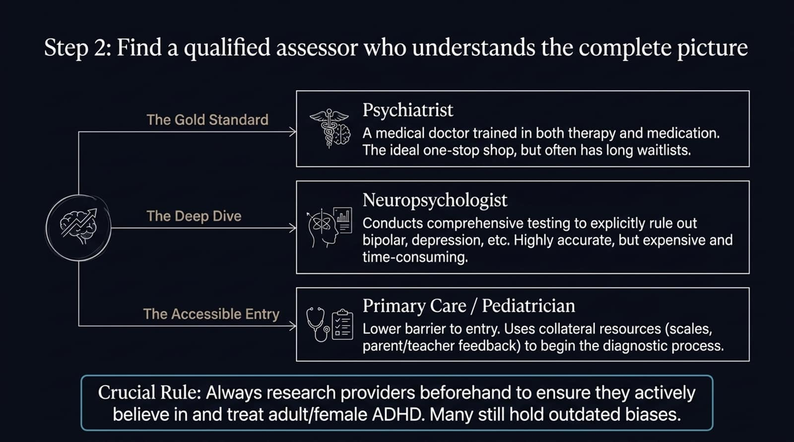
Notes:
Psychiatrist (The Gold Standard): Medical doctors who evaluate both physiological and psychological factors, offering medication and therapy in one place.
Neuropsychologist (The Deep Dive): Conducts extensive testing to rule out overlapping conditions. Thorough, though often time-intensive and costly.
Primary Care / Pediatrician (Accessible Entry): Lower barrier to entry using standardized rating scales and collateral feedback.
Crucial Rule: Vague or outdated perspectives on adult ADHD still persist. Vetting providers ahead of time helps ensure a supportive, informed diagnostic experience.
Delivery Tip: Reassure the audience that advocating for a qualified clinician is worth the effort.

Slide 13
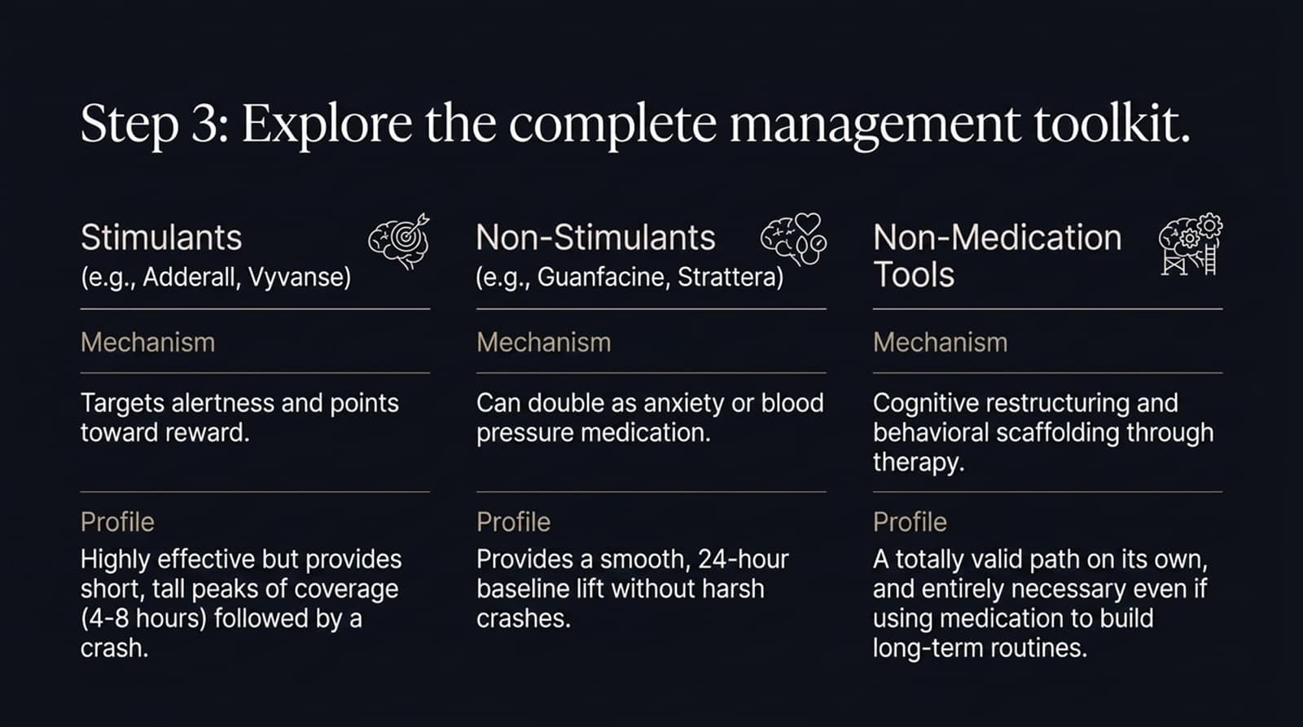
Notes:
Treatment is not one-size-fits-all:
Stimulants (e.g., Adderall, Vyvanse): Help improve alertness and focus. They offer target coverage (4–8 hours), but require managing potential drop-offs.
Non-Stimulants (e.g., Guanfacine, Strattera): Provide smooth, 24-hour baseline coverage without harsh crashes, often double-targeting overlapping anxiety.
Non-Medication Tools: Cognitive behavioral therapy, coaching, and environmental scaffolding are essential for building lasting routines—whether using medication or not.
Delivery Tip: Emphasize that choosing medication is a personal decision, and behavioral tools remain valuable either way.

Slide 14
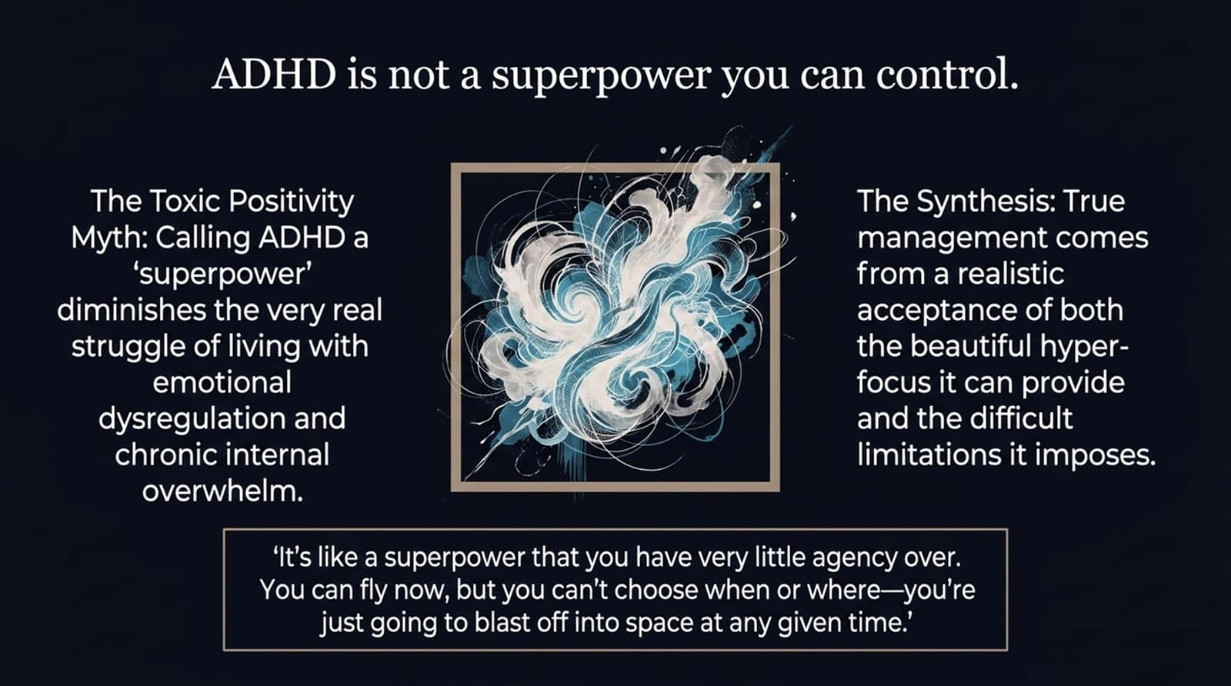
Notes:
There is a common narrative that "ADHD is a superpower." While well-intentioned, oversimplifying it can minimize the genuine burden of executive dysregulation.
As Dr. Hamdani puts it: "It's like a superpower that you have very little agency over. You can fly, but you can't choose when or where—you might just blast off into space at any given time."
True progress comes from accepting both sides: honoring creative hyperfocus while building practical guardrails for real limitations.
Delivery Tip: Deliver this with grounded honesty to validate the audience's lived challenges.

Slide 15
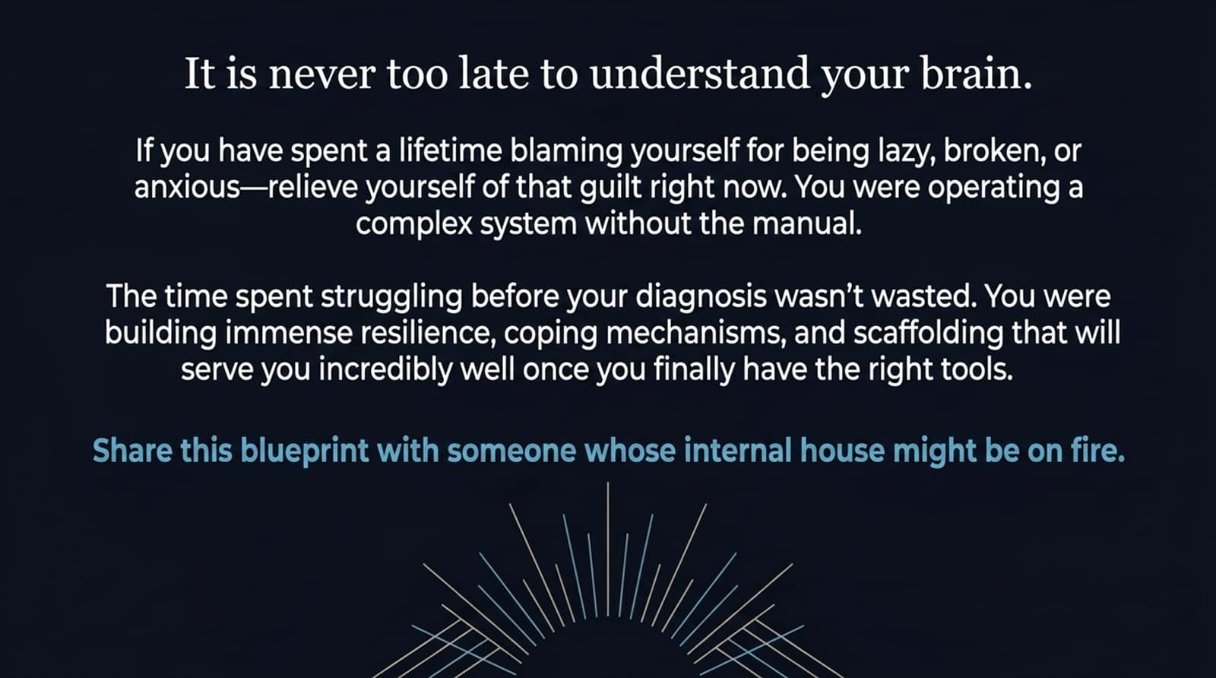
Notes:
If you spent decades blaming yourself for being "lazy," "broken," or "overly anxious," let go of that guilt today. You were navigating a complex system without the instruction manual.
The years spent struggling before a diagnosis weren't wasted. You were building resilience, adaptability, and creative problem-solving strategies.
Paired with the right understanding and tools, those hard-earned strategies become your strongest assets.
Delivery Tip: Speak with warmth and encouragement. Let the empowering message settle before moving to the final summary.

Slide 16
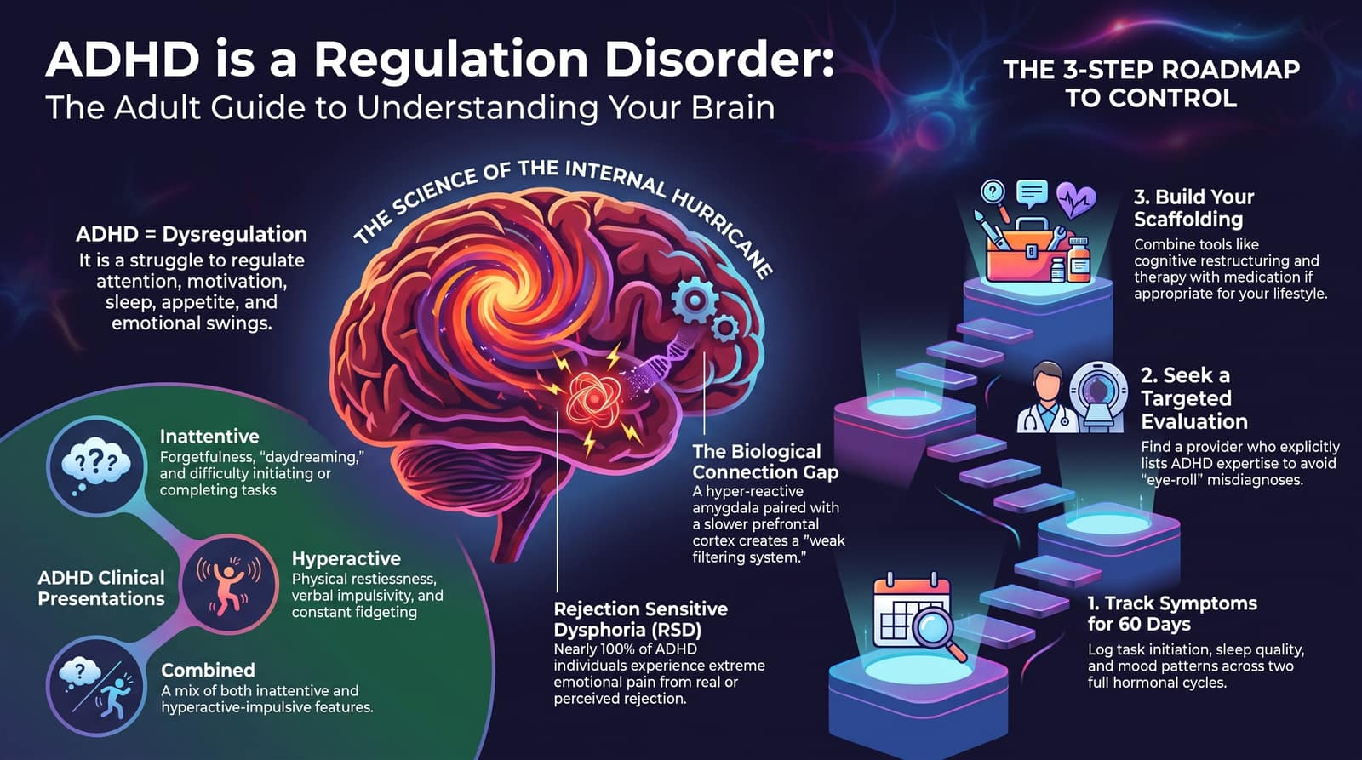
Notes:
To conclude, let's review our master blueprint:
Core Reality: ADHD is a dysregulation of attention, sleep, appetite, energy, and emotion.
Presentations: Recognizing whether you lean toward Inattentive, Hyperactive, or Combined features help guide your strategy.
Key Nuance: Understand how Rejection Sensitive Dysphoria (RSD) impacts your emotional reactions.
3-Step Roadmap: Log symptoms for 60 days $→$Seek an informed evaluation $→$Build your personalized toolkit combining therapy, routines, and optional medication.
Thank you for taking time to better understand your brain today.
Delivery Tip: Conclude with confidence, inviting questions and open discussion.

